Slide 1
Chapter 9: Marketing communications using digital media channels

Slide 2
Learning objectives
Distinguish between the different types of digital media channels and understand practical success factors to make them effective
Evaluate the advantages and disadvantages of each digital media channel for marketing communications
Assess the suitability of different types of digital media for different purposes

Slide 3
Chapter content
Search engine marketing (organic search and paid search)
Digital display advertising
Digital public relations and influencer relationship management
Digital partnerships including affiliate marketing
Digital messaging including email marketing and mobile messaging
Social media and viral marketing
Notes:
• What is it? A description of the digital media channel. • Advantages and disadvantages. A structured review of the benefits and drawbacks of • each channel.
Best practice in planning and management. A summary of the issues such as targeting, measurement and creative that need to be considered when running a campaign using each digital channel. This expands on the coverage given in the previous chapter on these issues.

Slide 4
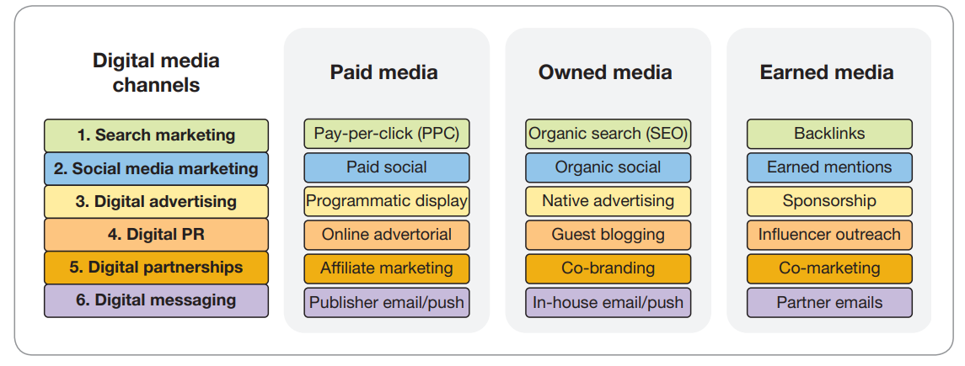

Slide 5
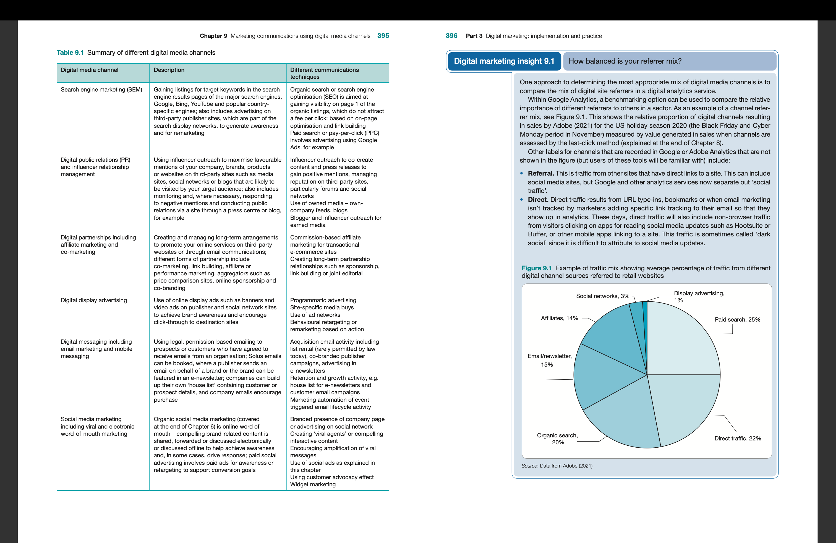

Slide 6
Search engine marketing
Search engine marketing (SEM): Promoting an organization through search engines to meet its objectives by delivering relevant content in the search listings for searchers and encouraging them to click through to a destination site.
The two key techniques of SEM:
Search engine optimization (SEO) to improve results from the natural listings
Paid search marketing to deliver results from the sponsored listings within the search engines.
Notes:
Note, in the United States and some European countries, the acronym SEM is sometimes used solely to describe paid search advertising. Confusing!

Slide 7
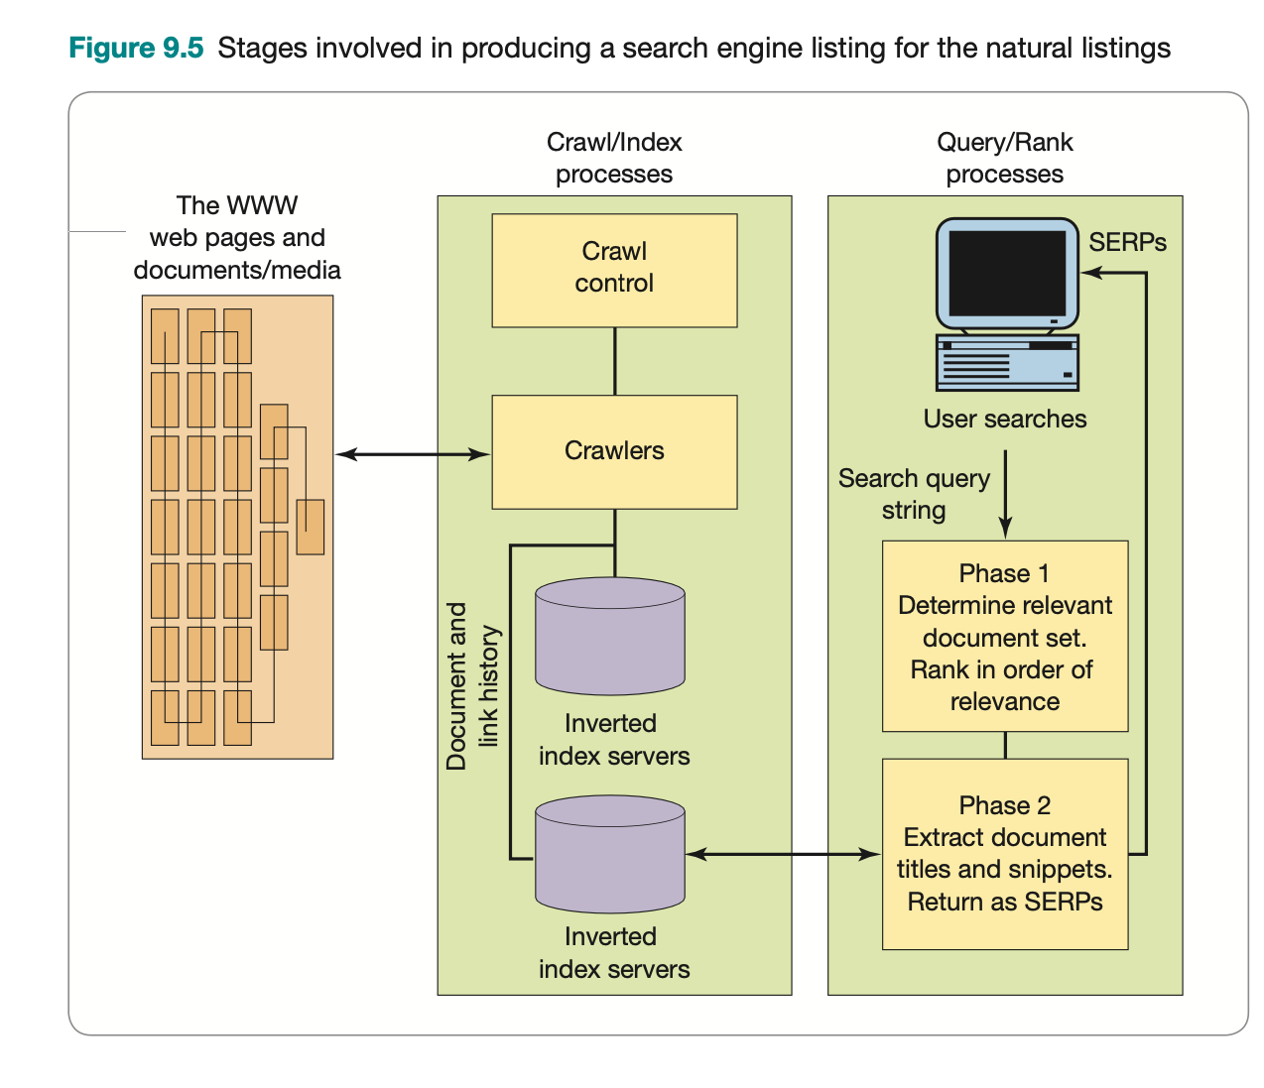
Search Engine Optimization - SEO
Definition: SEO or ‘organic search’ involves achieving the highest position or ranking practical in the natural or organic listings, below the ads on the search engine results pages (SERPs) across a range of specific combinations of keywords (or keyphrases) entered by search engine users.
2 most important factors for good ranking positions in all the main SE:
Matching between web page copy and the key phrases searched: on-page optimization
Links into the page (inbound or backlinks): external link building (off-page optimization) and internal link architecture
Notes:
- Khái niệm SEO (Search Engine Optimization): Tối ưu hóa công cụ tìm kiếm quá trình tăng chất lượng và lưu lượng truy cập website bằng cách tăng khả năng hiển thị của website hoặc webpage cho người dùng trên các máy truy tìm dữ liệu như Google, Bing, Yahoo,...
- Các bước chính của quá trình SEO:
+ Thu thập thông tin (crawling)
+ Lập các chỉ mục (indexing)
+ Đánh giá các điểm số ranking ( Ranking or scoring)
+ Truy vấn và đánh giá kết quả
At a top level, the two most important factors for good ranking positions in all the main search engines are:
• Matching between web page copy and the key phrases searched. The main factors to opti- mise on are ‘related keywords used on page’, keyword formatting, keywords in anchor text and the document metadata including page title tags. The SEO process to improve results in this area is known as on-page optimisation. We will cover some of the details
• of best practice for this process in a topic later in this section. Links into the page (inbound or backlinks). Google counts each link to a page from another page or another site as a vote for this page. So pages and sites with more exter- nal links from other sites will be ranked more highly. The quality of the link is also important, so if links are from a site with a good reputation and relevant context for the keyphrase, then this is more valuable. Internal links are also assessed in a similar way. Link quality tends to be higher for links with relevant anchor text from within a relevant article. The processes to improve this aspect of SEO are external link building and internal link architecture. To reduce the impact of webspam, search engines intro- duced nofollow tags, which means that links added to comments in blogs and social network updates have a limited impact, although it seems that many search spammers aren’t aware of this.

Slide 8
Search Engine Optimization - SEO
Advantages
Significant traffic driver: can attract a significant proportion of visitors to the site
Highly targeted: a high intent to purchase
Potentially low-cost visitors: no media costs for ad display or click-through; Costs arise solely from the optimi z ation process.
Dynamic: new content is included relatively quickly for the most popular pages of a site
Disadvantages
Lack of predictability: it is difficult to predict results for a given investment and is highly competitive.
Time for results to be implemented. The results from SEO may take months to be achieved, especially for new sites.
Complexity and dynamic nature.
The search engines take hundreds of factors into account
The relative weightings are not published, so there is not a direct correlation between marketing action and results – ‘it is more of an art than a science’;
The ranking factors change through time.
Ongoing investment. Investment is needed to continue to develop new content and generate new links.
Poor for developing awareness in comparison with other media channels. Searchers already have to be familiar with a brand or service to find it?
Notes:
Significant traffic driver. Figure 9.1 showed that search marketing can attract a significant
proportion of visitors to the site if companies are successful in implementing it.
Highly targeted. Visitors are searching for particular products or services so will often have a high intent to purchase – they are qualified visitors. Registering with Google My Business enables businesses with a physical presence to gain visibility in Google Maps
SERPs features. Potentially low-cost visitors. There are no media costs for ad display or click-through. Costs arise solely from the optimisation process where in-house staff or agencies are paid
to improve positions in the search results. Dynamic. The search engine robots will crawl the home page of popular sites daily, so new content is included relatively quickly for the most popular pages of a site (less so for deep links).
Lack of predictability. Compared with other media, SEO is very unreliable in terms of the return on investment – it is difficult to predict results for a given investment and is
highly competitive. Time for results to be implemented. The results from SEO may take months to be
achieved, especially for new sites. Complexity and dynamic nature. The search engines take hundreds of factors into account, yet the relative weightings are not published, so there is not a direct correlation between marketing action and results – ‘it is more of an art than a science’. Furthermore,
the ranking factors change through time. Ongoing investment. Investment is needed to continue to develop new content and gener-
ate new links. Poor for developing awareness in comparison with other media channels. Searchers already have to be familiar with a brand or service to find it. However, it offers the opportunity for less well-known brands to ‘punch above their weight’ and to develop awareness following click-through.

Slide 9
Search Engine Optimization - SEO
Best practice in planning and managing SEO
Search engine registration
Index inclusion
Keyphrase analysis
On-page optimization
External linking
SEO for mobile devices
Notes:
When a new site is launched, its pages need to be crawled for it to be included within the search engine index and potentially get visibility. Google advises new sites should be reg- istered by submitting new and updated URLs to verify site ownership on Search Console. Most existing companies and startups will be included automatically in the search index since the search engine robots will follow links from other sites that link to them and do not require submission services. New sites should seek to gain relevant backlinks to boost their authority in Google’s eyes. Google has allegedly placed new sites in a review status sometimes referred to as the Google sandbox effect. However, Google search engineers deny the existence of this and explain it is a natural artefact produced by new sites having limited links from other sites, history and thus reputation. However, it is important to remember this constraint when creating startup companies or separate unlinked microsites for a cam- paign since you may have to rely on paid search to gain SERPs visibility.
It is useful for business owners with a physical presence to register with Google My Business so their business may be displayed prominently in a Google Maps SERPs feature. Local search engine optimisation involves increasing visibility for geographically constrained searches by improving the quality of images, product listings, reviews and backlinks for retail locations.
2 Index inclusion
Although a search engine robot may visit the home page of a site, it will not necessarily crawl all pages or assign them equal weight in terms or relevance. So, when auditing sites as part of an SEO initiative, SEO agencies will check how many pages are included within the search engine index for different search engines. This is known as index inclusion.
Among the potential reasons for not gaining complete index inclusion are:
• Technical reasons why the search robots do not crawl all the pages, such as the use of • SEO-unfriendly content management systems with complex URLs.
Pages identified as webspam or of less importance, or considered to be duplicate content, which are then contained in what used to be known as the supplemental index in Google and don’t rank so highly. In these cases, it is sometimes best to use a specific ‘canonical’ meta tag, which tells the search engine which is the primary page. If you are a multina- tional company with different content sites for different countries, then it can be chal- lenging to deliver the relevant content for local audiences, with use of regional domains tending to work best, but there are specialist techniques such as hreflang code markup, which can be used to tell Google which country and language a page is intended for.
Companies can check the index inclusion by means of:
using web analytics referrer information to find out which search engines a site’s visitors
originate from, and the most popular landing pages;
checking the number of pages that have been successfully indexed on a site – for example, in Google the search ‘inurl:www.smartinsights.com’ or ‘site:www.smartinsights.com’ lists all the pages of Dave’s site indexed by Google and gives the total number in the top-right
of the SERPs; using Google Search Console – a free service that site owners can register with that shows pages indexed and potential webspam problems, such as the penalties that may result in reduced search rankings (described in Digital marketing insight 9.2).

Slide 10
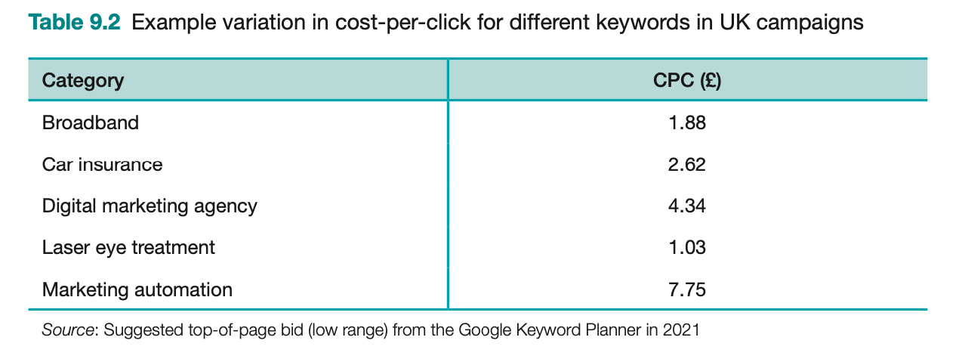
Paid search marketing - PPC
Paid search (pay-per-click) marketing (PPC): A relevant text ad with a link to a company page is displayed on the SERPs when the user of a search engine types in a specific phrase.
- A fee is charged for every click of each link, with the amount bid for the click mainly determining its position. Additionally, PPC may involve advertising through a display network of third-party sites (which may be on a CPC, CPM or CPA basis).
Notes:
PPC là tên viết tắt của “Pay Per Click”, nghĩa là quảng cáo trên công cụ tìm kiếm có tính phí cho mỗi lượt click. PPC là một hình thức của SEM và cũng là một phần trong Google Adwords.
=> PPC sẽ giúp website của bạn xuất hiện ở vị trí đầu tiên trên trang kết quả tìm kiếm

Slide 11
Paid search marketing - PPC
Advantages
The advertiser is not paying for the ad to be displayed. Cost is only incurred when an ad is clicked on and a visitor is directed to the advertiser’s website.
PPC advertising is highly targeted
Good accountability
Predictable
Technically simpler than SEO
Remarketing: Google offers a remarketing option for retargeting through cookies placed on the searcher’s computer to display ads on the content network after someone has clicked on a paid search ad or visited a specific page on a site as a reminder to act.
Prospecting with Customer Match. By uploading a list of email addresses of prospects or customers, i.e. similar audiences, Google can serve ads to people who are similar in terms of their profile and behaviour.
Speed
Branding. Tests have shown that there is a branding effect with PPC, even if users do not click on the ad.
Artificial intelligence tools.
Disadvantages
Competitive and expensive
Inappropriate. It might not be cost-effective to compete for companies with a lower budget or a narrower range of products on which to generate lifetime value
Requires specialist knowledge. PPC requires a knowledge of configuration, bidding options and of the reporting facilities of different ad networks.
Time-consuming. To manage a PPC account can require daily or even hourly checks on the bidding in order to stay competitive.
Irrelevant. Sponsored listings are only part of the search engine marketing mix. Many search users do not click on these because they don’t trust advertisers, although these are mainly people involved in marketing.
Notes:
•
• •
• •
• •
• •
The advertiser is not paying for the ad to be displayed. As we explained at the start of Chapter 8, wastage is much lower with paid search compared to traditional advertising. Cost is only incurred when an ad is clicked on and a visitor is directed to the advertiser’s website. Hence it’s a cost-per-click (CPC) model! However, there are increasingly options for paid search marketing using other techniques – Google also offers CPM (site target- ing) options on the Google Display Network (GDN), where contextual ads are displayed on third-party sites relevant to the content on a page.
PPC advertising is highly targeted. The relevant ad with a link to a destination web page is only displayed when the user of a search engine types in a specific phrase (or the ad appears on the content network, triggered by relevant content on a publisher’s page), so there is limited wastage compared to other media. YouTube users can also be targeted through Google’s ‘promoted video’ PPC option. Users responding to a particular keyphrase or reading related content have high intent or interest and so tend to be good-quality leads. Good accountability. With the right tracking system, the ROI for individual keywords can be calculated.
Predictable. Traffic, rankings and results are generally stable and predictable in compari- son to SEO. If budget is available to compete, it will be possible to attract relevant traffic. Merkle (2020) reports that for smartphones, the average percentage of search clicks on ads in the United States is around 70 per cent while for desktop it is significantly lower at 30 per cent.
Technically simpler than SEO. Position is based on combination of bid amount and qual- ity score, whereas SEO requires long-term, technically complex work on page optimisa- tion, site restructuring and link building. Remarketing. Google offers a remarketing option for retargeting through cookies placed on the searcher’s computer to display ads on the content network after someone has clicked on a paid search ad or visited a specific page on a site as a reminder to act. RLSA (remarketing lists for search ads) is a retargeting option where ads are displayed in the SERPs where someone has previously interacted with a brand. These can be effective in boosting the conversion rate to lead or sale.
Prospecting with Customer Match. By uploading a list of email addresses of prospects or customers, i.e. similar audiences, Google can serve ads to people who are similar in terms of their profile and behaviour. Speed. PPC listings get posted quickly, usually in a few days (following editor review). SEO results can take weeks or months to be achieved. Moreover, when a website is revised for SEO, rankings will initially drop while the site is re-indexed by the search engines.
Branding. Tests have shown that there is a branding effect with PPC, even if users do not click on the ad. This can be useful for the launch of products or major campaigns.
Artificial intelligence tools. Provided by Google and other providers, these can be used to automate the targeting and bidding process. Google provides ‘Smart campaigns’, which use machine learning from historical search data to select target keywords and bids to achieve goals; however, it provides granular analysis and control. ‘Smart Shopping’ pro- vides automation for retailer product feeds aiming to maximise conversion value.
There are disadvantages to be managed, some of which are reduced by the new AI-based tools:
• Competitive and expensive. Since pay-per-click has become popular, some companies may get involved in bidding wars that drive bids up to an unacceptable level. Some phrases such as ‘car insurance’ can exceed £10 per click.
414 Part 3 Digital marketing: implementation and practice
• Inappropriate. For companies with a lower budget or a narrower range of products on • which to generate lifetime value, it might not be cost-effective to compete.
Requires specialist knowledge. PPC requires a knowledge of configuration, bidding
options and of the reporting facilities of different ad networks. Internal staff can be • trained, but they will need to keep up to date with changes to the paid search services.
Time-consuming. To manage a PPC account can require daily or even hourly checks on
the bidding in order to stay competitive. This can amount to a lot of time. The tools and • best practice vary frequently, so keeping up to date is difficult.
Irrelevant. Sponsored listings are only part of the search engine marketing mix. Many search users do not click on these because they don’t trust advertisers, although these are mainly people involved in marketing!

Slide 12
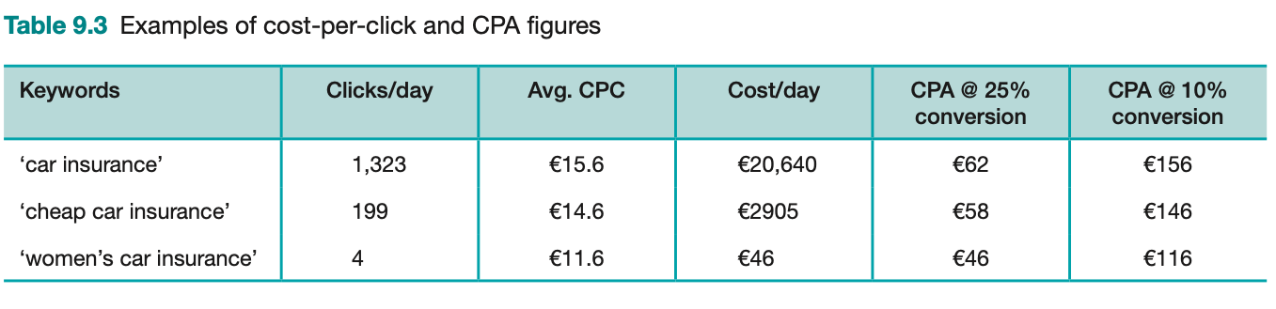
Paid search marketing - PPC
Best practice in planning and managing PPC: Optimising pay-per-click
Targeting: Search ad network strategy; Display network strategy; Campaign structure strategy; Keyword matching strategy; Search-term targeting strategy.
Budget and bid management
Creative testing and campaign optimization
Communications integration
Notes:
1 Targeting
• Search ad network strategy. Which of the search networks mentioned above do you use? • Which are used in different countries?
Display network strategy. How do you treat the Google Display Network? Do you disable
it? Create separate campaigns? Target specific sites using the Placement tool? Develop • different creative? Use placement targeting to target specific sites in Google?
Campaign structure strategy. Campaign structure is important to ensure that searches using a specific search term trigger the relevant ad creative. Are ad groups small enough to deliver a message relevant for the keyphrase entered? To understand the type of targeting that is possible, look at these two examples. First, in Figure 9.7(a) we have a campaign structure for an online clothes retailer. It monitors spend and budget by product type, so structures its campaigns accordingly and targets them nationally. Keywords related to each product will trigger ads defined within each ad group. In Figure 9.7(b) is an example
of a campaign for a restaurant chain. It monitors spend and budget by outlet, so struc-
tures its campaigns accordingly and targets them to local areas.
Keyword matching strategy. How is creative targeted using the combination of broad match, modified broad match and negative match, phrase match and exact match? Google Ads reports on click volumes for search terms or queries entered by users; these should be reviewed regularly to exclude irrelevant terms that have a low probability of
conversion by using negative matches. Search-term targeting strategy. What are the strategies for targeting different types of keyphrases such as brand, generic, product-specific and different qualifiers (cheap, com- pare, etc.)?
2 Budget and bid management
Budgeting strategy. Is budget set as maximum cost-per-click (CPC) at the appropriate level to deliver satisfactory return on investment? Is daily budget sufficient that ads are served at full delivery (always present)? Should we use Google’s machine learning bid
management tools, which can, for example, optimise on conversions? Listing position strategy. Which positions are targeted for different keywords? The effec- tiveness of this can be reviewed using a measure in Google Ads reports called Impression
Share, which enables relative reach compared to competitors to be evaluated. Bidding strategies. What is the appropriate maximum cost-per-click for different target
keywords and campaigns to maximise effectiveness? Dayparting strategy. Are ads delivered continuously through the day and week or are
certain days and times targeted (e.g. office hours, evening after ad breaks)? Bid adjustments. This is a tool to simplify the complexity of advertising when different types of mobile devices can be targeted in different locations at different times. If a business isn’t seeing such a high return on mobile devices then it can reduce
bids. Bid management tool strategy. Is a tool used to automate bidding? Which? Importance of fake clicks. Whenever the principle of PPC marketing is described to mar- keters, very soon a light bulb switches on and they ask, ‘So we can click on competitors and bankrupt them?’. Well, actually, no. The PPC ad networks detect multiple clicks from the same computer (IP address) and filter them out.
3 Creative testing and campaign optimisation
Ad creative and copy strategy. How are the 95 characters forming ad headlines, descrip- tion and creative used to encourage click-through (and reduce click-through from unqual-
ified visitors if necessary)? Is alternative copy tested? How are ads tested?
Destination or landing page strategy. How are landing pages improved?
Campaign review and optimisation strategy. What is the workflow for reviewing and
improving success? Which reports are used? How often are they reviewed? By whom?
Which tests are used? What are the follow-ups?
Specialist and innovative paid search techniques. These include ad extensions, local, inter- national and pay-per-call.
4 Communications integration
SEO integration strategy. How is SEO integrated with paid search to maximise ROI by reducing PPC spend where relevant if target keyphrases rank highly within organic
search? Affiliate integration strategy. How is affiliate marketing integrated with paid search to
maximise ROI? Marketing campaign integration strategy. How are budget and creative changed during offline campaigns?

Slide 13
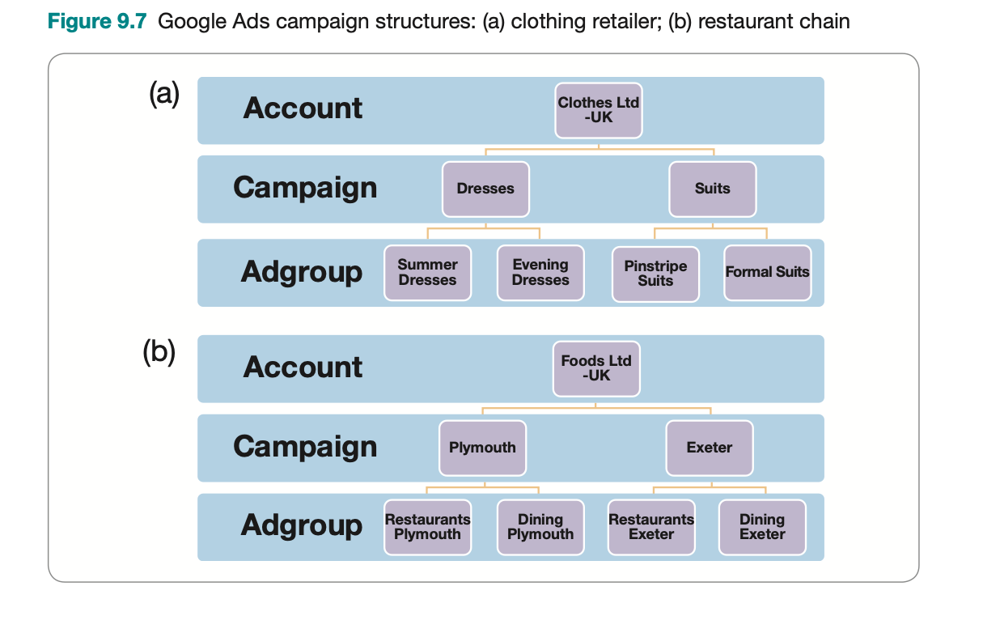
Paid search marketing - PPC

Slide 14
Digital display advertising
Definition: Display ads are paid ad placements using graphical or rich media ad units within a web page or app to achieve goals of delivering brand awareness, familiarity, favourability and purchase intent. Many ads encourage interaction through prompting the viewer to interact or ‘rollover’ to play videos, complete an online form or to view more details by clicking through to a site.
Range of ad formats:
Purchasing ad placements: Display advertising is purchased for a specific period.
the run-of-site (the entire site);
a section of site;
according to keywords entered on a search engine
Programmatic ad buying
Notes:
- Khái niệm: Đây là một hình thức quảng cáo thuộc kênh Digital Marketing – một trong các kênh marketing phổ biến hiện nay. Theo đó marketer sẽ sử dụng quảng cáo biểu ngữ cùng với các định dạng quảng cáo trực quan khác để quảng cáo sản phẩm của họ trên các trang web, ứng dụng hoặc phương tiện truyền thông xã hội
Nhóm phương tiện:
+ Quảng cáo lập trình sẵn
+ Quảng cáo tự nhiên có trả phí
+ Quảng cáo qua hoạt động tài trợ
Traditionally, the most common payment is according to the number of customers who view the page as a cost-per-thousand (CPM) ad or page impressions. Typical CPM is in the range £10–30. Other options that benefit the advertiser if they can be agreed are per click-through or per action, such as a purchase on the destination site. Although initially media owners were able to control charging rates and largely used a per-exposure model, with the increase in unused ad inventory there has also been an increase in results-based payment methods, particularly within ad networks.
The options for purchasing and managing display advertising are now much more complex, as suggested by the summary in Figure 9.10 of the ad buying ecosystem created by the IAB. A major change in online advertising is through the use of new programmatic ad buy- ing techniques, based on demand-side platforms (DSPs), which use an approach called real-time bidding (RTB). Progammatic ads now account for the majority of online display advertising by large companies (excluding spend on search and social network ads), see for example Joseph (2020). Traditionally, display ads have been served to target audiences based

Slide 15
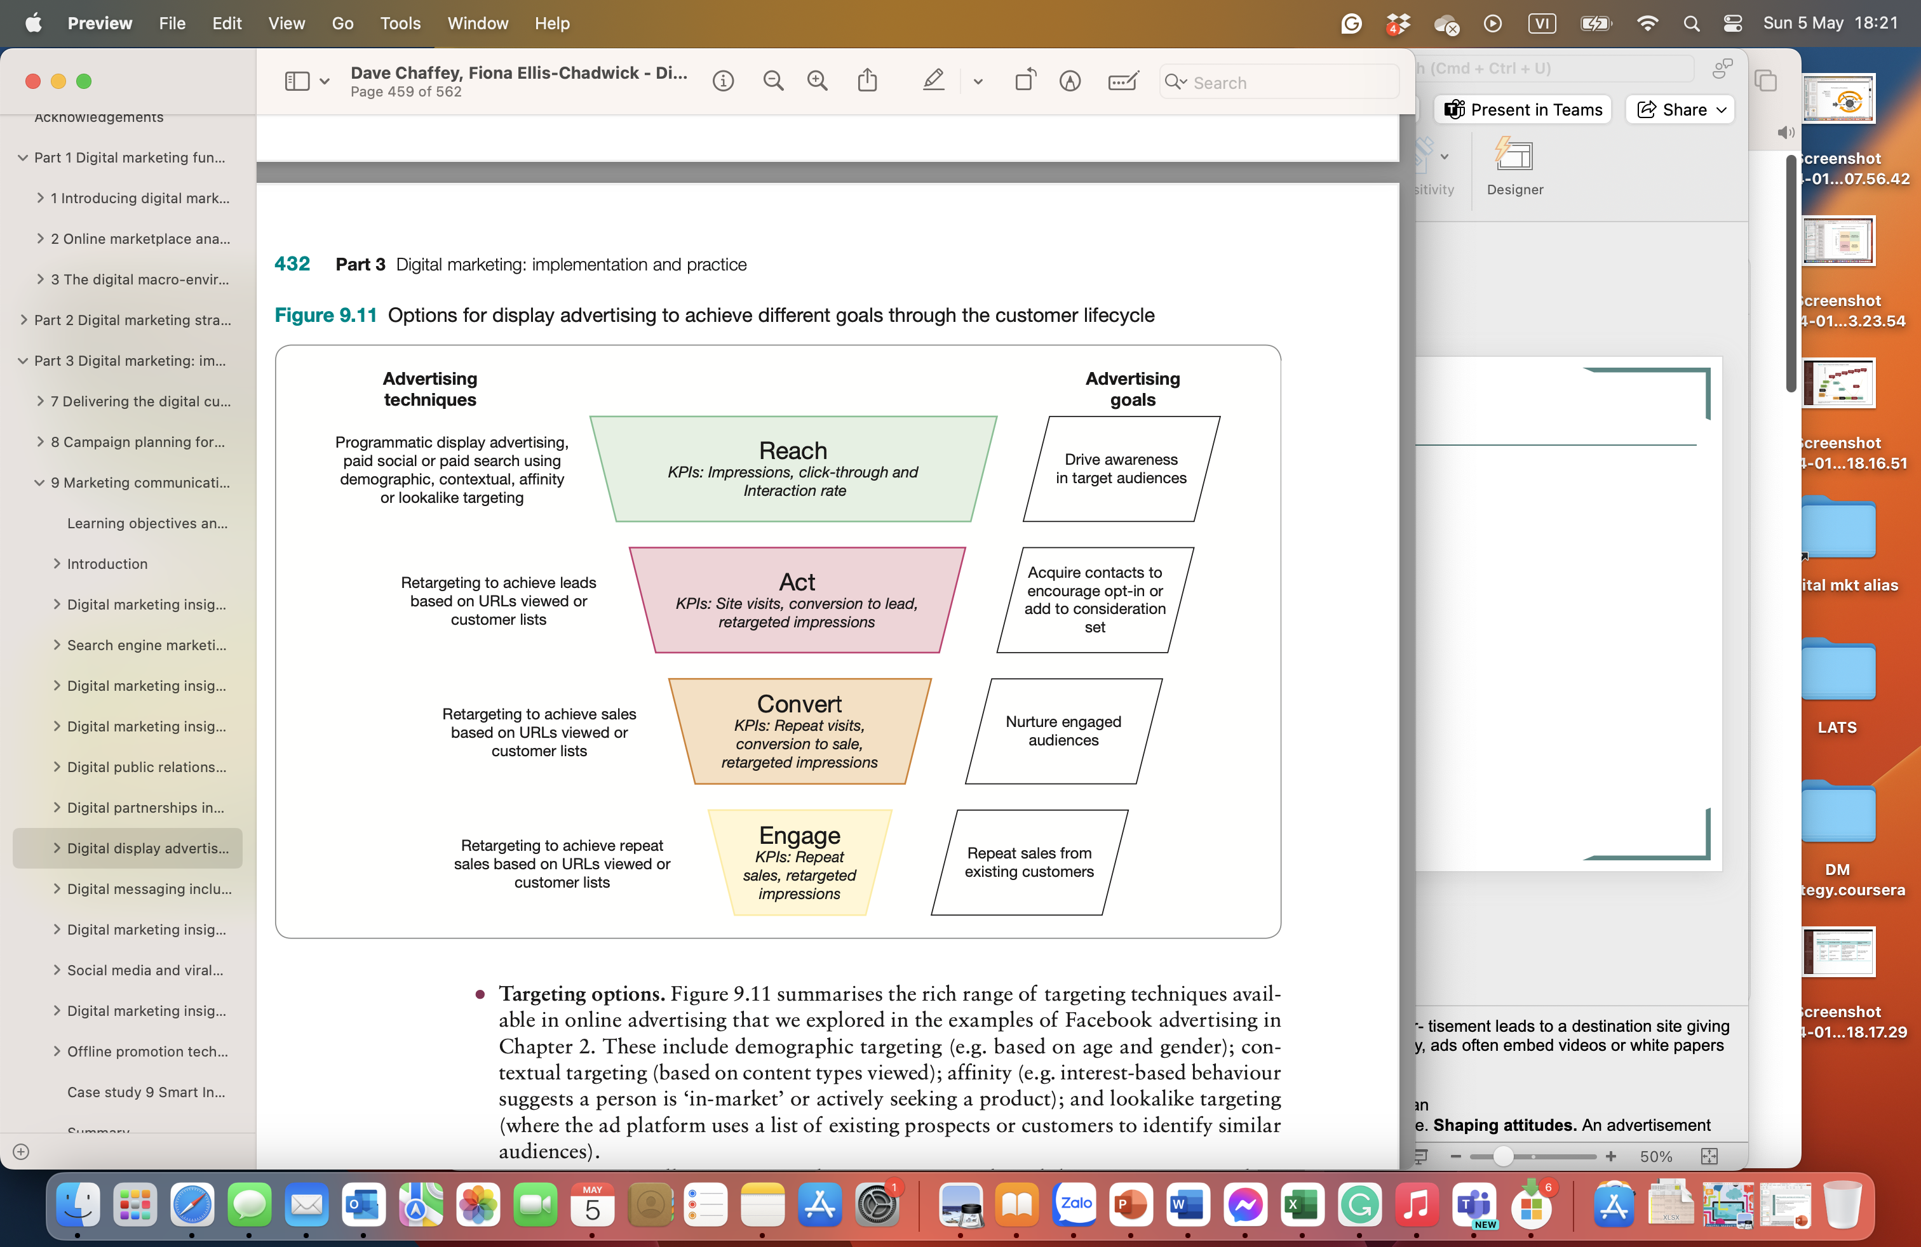
Digital display advertising
Advantages
Reach to drive awareness.
Direct response
Targeting options
Retargeting
Advertising is now available for smaller advertisers.
Indirect response. CTR is so low but viewers of an ad may later visit a website or search on the brand or category
Media-multiplier or halo effect. Repeated exposure to ads online, particularly in association with other media, can increase brand awareness and ultimately purchase intent.
Achieving brand interactions
Targeting.
Cost.
Dynamic updates to ad campaigns.
Accountability.
Notes:
Delivering content. This is the typical case where a click-through on a banner adver- tisement leads to a destination site giving more detailed information on an offer. This is where a direct response is sought. Today, ads often embed videos or white papers to
deliver content directly within the ad. Enabling transaction. If a click-through leads to a merchant such as a travel site or an
online bookstore this may lead directly to a sale. A direct response is also sought here. Shaping attitudes. An advertisement that is consistent with a company brand can help
build brand awareness. Soliciting response. An advertisement may be intended to identify new leads or as a start for two-way communication. In these cases, an interactive advertisement may encourage
a user to type in an email address or other information. Encouraging retention. The advertisement may be placed as a reminder about the com- pany and its service and may link through to on-site sales promotions such as a prize draw.
Reach to drive awareness. A media mix buying programmatic display, paid social or Google Display Network paid search ads enables companies to reach and influence con- sumers and business people as they use publisher sites and social networks. This is meas- ured by number of ad impressions served. The visual imagery of a display ad can generate
awareness about a brand, product or need. Direct response. Display advertising can generate an immediate direct response measured as interaction with an ad or click-through to a website, enabling transaction for retail products, for example. Figure 9.11 shows that a common goal will be able to achieve conversion to a lead on a destination site, which will then be nurtured using retargeting.
• Targeting options. Figure 9.11 summarises the rich range of targeting techniques avail- able in online advertising that we explored in the examples of Facebook advertising in Chapter 2. These include demographic targeting (e.g. based on age and gender); con- textual targeting (based on content types viewed); affinity (e.g. interest-based behaviour suggests a person is ‘in-market’ or actively seeking a product); and lookalike targeting (where the ad platform uses a list of existing prospects or customers to identify similar
• audiences). Retargeting. As well as raising initial awareness, ‘reminder’ ads have an important role in reminding people who have already interacted with a brand to nudge them along the path to purchase by encouraging repeat visits, conversion to lead and sale. Retargeted ads are available through the Google Display Network, which covers many publisher sites, on ad networks (e.g. Criteo, which is used by retailers) and social networks including Facebook, LinkedIn and Twitter. Retargeting is available by targeting known audiences in a ‘cookie
• pool’ or by uploading lists of known people who have interacted with a site. Advertising now available for smaller advertisers. Previously, ad buying online was limited to larger advertisers. But now a small business can purchase a small-scale, highly targeted ad campaign for a few dollars using the Google Display Network options in Google Ads or the advertising programmes available on the social networks such as Facebook, Twitter or LinkedIn. They can now use self-service tools such as AdRollTM (www.adroll.com) to retarget across all of these to boost conversion. Indirect response. We will see in the section on the disadvantages of display advertising that click-throughs are so low that it suggests display advertising is not worthwhile. However, the indirect response, where viewers of an ad later visit a website or search on
• the brand or category, should not be underestimated. Media-multiplier or halo effect. Repeated exposure to ads online, particularly in asso- ciation with other media, can increase brand awareness and ultimately purchase intent. Furthermore, practitioners report a media-multiplier or halo effect of buying online ads, which can help increase the response rates from other online media. For example, if a web user has been exposed to banner ads, this may increase their response to paid search ads and may also increase their likelihood of converting on a site since brand awareness and trust may be higher.
• Achieving brand interactions. Many modern display ads comprise two parts – an initial visual encouraging interaction through a rollover, and then another visual or application encouraging interaction with a brand. This enables advertisers to calculate an interaction
• rate (IR) to assess the extent to which viewers interact with a brand ad. Targeting. Media buyers can select the right site or channel within a site to reach the audi- ence (e.g. a specialist online car magazine or review site or the motoring channel within an online newspaper or TV channel site). Audiences can also be targeted via their profile through serving personalised ads, or ads in emails if visitors have registered on a site. Behavioural retargeting options are used in an ad network to preferentially serve an ad to someone who seems to have an interest in a topic from the content they consume. Effectively the ad follows the viewer around the site. For example, if someone visits the car section of a site, then the ad is served to them when they view other sections of the site. Retargeting can work across an ad network too and can even be sequential, where the messages are varied for an individual the more times they are exposed to the ad. Search retargeting offers the option to display an ad after a visitor has searched on a particular
term, such as a car marque. Tracking of individuals is achieved through use of cookies. Cost. There are opportunities to buy online media at a cheaper rate compared to tradi- tional media, although this is less true in focused, competitive markets such as financial services, where there is limited premium inventory for media buyers to purchase. Programmatic advertising and ad networks give advertisers the options of advertising across a network of sites to reach a particular demographic, e.g. female 18–25 with specific interests, but at a lower cost than media buys on a specific site since the actual site used for the ad placement isn’t known (hence these are sometimes known as ‘blind network buys’). Lower CPMs are achievable, and in some cases CPC or CPA payment options are available. Site owners such as publishers use ad networks since it gives them
a method of gaining fees from unused ad inventory that has not sold at premium rates. Dynamic updates to ad campaigns. In comparison with traditional media, where media placements have to be bought weeks or months in advance, online ads are more flexible since it is possible to place an advertisement more rapidly and make changes during the campaign. Experienced online advertisers build in flexibility to change targeting through time. Best practice is to start wide and then narrow to a focus – allow 20 per cent of the budget for high-performing ad placements (high CTR and conversion).
In an iMediaConnection (2003) interview with ING Direct VP of Marketing, Jurie Piet- erse, the capability to revise creative is highlighted:
Another lesson we learnt is the importance of creative. It’s critical to invest in developing various creative executions to test them for best performance and constantly introduce new challengers to the top performers. We’ve also learnt there’s no single top creative unit – different creative executions and sizes perform differently from publisher to publisher.
• Accountability. As we will discuss later in the section, it is readily possible to measure reach, interaction and response to ads. However, it is more difficult to measure brand impact.

Slide 16
Digital display advertising
Disadvantages
Relatively low click-through rates. around 0.1 to 0.2 percent. However, the use of new ad formats such as native advertising and widget marketing means that there are other ways to get cut-through.
Relatively high costs or low efficiency.
Brand reputation. Brands can potentially be damaged in the consumers’ minds if they are associated with some types of content such as gambling, pornography or racism. It is difficult to monitor precisely which content an ad is served next to when millions of impressions are bought across many sites; this is particularly the case when using ad networks. Managing technology complexity.
Notes:
Relatively low click-through rates. When discussing online ads, many web users will state they ignore ads and find them intrusive. Published click-through rates support this, with most compilations showing response rates of around 0.1 to 0.2 per cent, but with rich media formats such as video ads attracting higher click-through rates. This phenomenon is known among practitioners as ‘banner blindness’. The first 468 * 68 pixel banner ad was placed on HotwiredTM in 1995 and the call-to-action ‘Click here!’ generated a click-through of 25 per cent. Since then, the click-through rate (CTR) has fallen dramati- cally, with many consumers suffering from banner blindness – they ignore anything on a website that looks like an ad. Remember, though, that for reasons such as awareness generation and the media-multiplier effect, digital marketers should not dismiss online advertising as ineffectual based on click-through rates alone. It should also be remem- bered that the use of new ad formats such as native advertising (which we introduced in Chapter 3) and widget marketing mean that there are other ways to get cut-through. Relatively high costs or low efficiency. When the low response rates are combined with relatively high costs of over £10 per thousand, this makes online ads an inefficient medium. Brand reputation. Brands can potentially be damaged in the consumers’ minds if they are associated with some types of content such as gambling, pornography or racism. It is difficult to monitor precisely which content an ad is served next to when millions of impressions are bought across many sites; this is particularly the case when using ad
networks. Managing technology complexity. Joseph (2020) gives an example of how larger advertis- ers may have a challenge of integrating with many technology providers to support their advertising. The article explains how the head of programmatic advertising at Diageo is seeking to consolidate the number of programmatic platforms from more than 10 with the aim of gaining better insights and cost-efficiencies from work with fewer adtech partners.

Slide 17
Digital display advertising
Best practice in planning and managing display ad campaigns
Measurement of display effectiveness: Page and ad impressions; Reach; Cost-per-thousand (CPM); Interaction rate (IR), Effective frequency, Click-through, View-through
Interactive ad formats:
popular format: video ads, rich-media ads and larger-format rectangles (multipurpose units, MPUs) and skyscrapers; Interstitial ads, overlays
Vs. users who deploy pop-up blockers, or ad-blocking software
Interactive ad targeting options:
Programmatic, based on real-time auctions
Traditional approaches: On a particular type of site (or part of site), To target a registered user’s profile; At a particular time of day or week; To follow users’ behaviour (Behavioural ad targeting).
Ad creative: banner size; message length; promotional incentive; animation; action phrase (commonly referred to as a call-to-action); company brand/logo.
Figure 9.12 Behavioural ad targeting process
Notes:
interstitial ads (intermediate adverts before another page appears) and the more common overlays (formerly more often known as superstitials or overts) that appear above content and, of course, pop- up windows that are now less widely used because of their intrusion.
Theo thông tin từ Youtube, tới đây hình thức quảng cáo Overlays Ads sẽ biến mất khỏi nền tảng này.

Slide 18
Digital public relations and influencer relationship management
Public relations (PR): The management of the awareness, understanding and reputation of an organisation or brand, primarily achieved through influencing exposure in the media.
Digital public relations (online PR): Maximising favourable mentions of your company, brands, products or websites on third-party websites that are likely to be visited by your target audience. Online or digital PR can extend reach and awareness of a brand within an audience and will also generate backlinks vital to SEO. It can also be used to support viral or word-of-mouth marketing activities in other media.
Online influencer outreach: Identifying online influencers such as bloggers, media owners or individuals with a large online following in the social networks and then approaching them to partner together to communicate with their audience.
Influencer relationship management (IRM): A structured process to continuously manage and measure influencer outreach as a program of campaigns based on content assets and ‘always-on’ activities against defined goals.
Notes:
- Khái niệm: Đây là một hình thức quảng cáo thuộc kênh Digital Marketing – một trong các kênh marketing phổ biến hiện nay. Theo đó marketer sẽ sử dụng quảng cáo biểu ngữ cùng với các định dạng quảng cáo trực quan khác để quảng cáo sản phẩm của họ trên các trang web, ứng dụng hoặc phương tiện truyền thông xã hội
Nhóm phương tiện:
+ Quảng cáo lập trình sẵn
+ Quảng cáo tự nhiên có trả phí
+ Quảng cáo qua hoạt động tài trợ
Traditionally, the most common payment is according to the number of customers who view the page as a cost-per-thousand (CPM) ad or page impressions. Typical CPM is in the range £10–30. Other options that benefit the advertiser if they can be agreed are per click-through or per action, such as a purchase on the destination site. Although initially media owners were able to control charging rates and largely used a per-exposure model, with the increase in unused ad inventory there has also been an increase in results-based payment methods, particularly within ad networks.
The options for purchasing and managing display advertising are now much more complex, as suggested by the summary in Figure 9.10 of the ad buying ecosystem created by the IAB. A major change in online advertising is through the use of new programmatic ad buy- ing techniques, based on demand-side platforms (DSPs), which use an approach called real-time bidding (RTB). Progammatic ads now account for the majority of online display advertising by large companies (excluding spend on search and social network ads), see for example Joseph (2020). Traditionally, display ads have been served to target audiences based

Slide 19
Digital public relations
Differences between online PR and traditional PR
Four key differences (Ranchhod et al. (2002):
The audience is connected to organizations.
The members of the audience are connected.
The audience has access to other information.
Audiences pull information.
For the marketer or PR professional managing PR, the main differences are :
Less easy to control. There are many more places a brand can be discussed online
More options to create their own stories. Since a company will have its own site, press centre, feeds and blogs, it is possible to bypass other media owners to some extent.
Need for faster response. It is often said that ‘bad news travels fast. Rapid-response ‘crisis communications’ teams are needed. Some brands have created a social media command centre as part of a social media governance process based on social media listening.
Opportunities for proactive real-time campaigns. Businesses can take advantage of current public interest in breaking news to gain awareness, sometimes known as ‘newsjacking’.
Easier to monitor. Since Google and online reputation management tools index many pages, it is arguably easier to identify when a brand is discussed online.
Notes:
Less easy to control. There are many more places a brand can be discussed online, such as in blogs and forums, compared to traditional media where there are a smaller number
• of media outlets with news filtered through journalists and other editorial staff. More options to create their own stories. Since a company will have its own site, press centre, feeds and blogs, it is possible to bypass other media owners to some extent. Many
• companies have now created a ‘social media newsroom’. Need for faster response. It is often said that ‘bad news travels fast’. This has been facili- tated online and a ‘social media storm’ can soon arise where many are critical of a brand’s action. Rapid-response ‘crisis communications’ teams are needed. Some brands have cre- ated a social media command centre as part of a social media governance process based on social media listening.

Slide 20
Digital public relations
Advantages
Reach. Online PR can be a relatively low-cost method of directly reaching a niche audience, or a mass audience if the brand is amenable to stories that are of interest to publishers.
Cost. The costs for online PR are the agency or internal staff fees for developing the online PR plan, concepts and content. Since there are no media placement costs, this can be cost-effective.
Credibility. Comments that are made by a person independent from a company are considered more authentic and so can help raise trust about an online provider such as a retailer.
Search engine optimization.
Brand enhancement and protection. Favorable stories can enhance the reputation of a brand among its target audience and amplification through influencers can help reach a new audience.
But since unfavourable media mentions may damage a brand, so monitoring and response to these is a necessity for most brands.
Disadvantages
It is not a controlled discipline like online advertising techniques such as pay-per-click marketing or display advertising
it could be considered a high-risk investment
May solicit negative comments → exist counter-arguments
Notes:
However, there are counter-arguments to this, namely that it is best to control and be involved with conversations about a brand on the site rather than when it is less controlled on third-party sites. For example, car brands such as Honda and Volvo enable web users to make comments about their cars, which are published on the site; this shows they are transparent, listening to customer comments and gaining valuable sentiment that can feed into new product development ideas.

Slide 21
Digital public relations and influencer relationship management
Best practice for online public relations and IRM:
Segmenting influencers
Everyday influencers.
Brand advocates. A customer who is highly satisfied with your product/brand, who tends to spread positive word of mouth, content and recommendations without being paid to do so.
Micro-influencers. Have a relatively low reach but are highly relevant, tend to enjoy high engagement rates and create high-quality content on a blog or social media
Professional influencers. These influencers have sufficient reach and potential impact that they are paid, or their content supports their business or personal aims. They typically get referenced by their peer influencers as the authority on certain topics or product categories:
Macro-influencers.
Celebrity influencers.
Assessing influence: 4Rs framework (Onalytica (2017)
High relevance is where influencers are focused/known for discussing a topic that is of interest to an audience and related to a product or service.
High resonance demonstrates that the influencer is creating an impact with their audience, rather than having a large audience that they fail to engage.
High reference is useful for identifying thought leaders or conference speakers who are respected as an authority by their peer influencers. This can emphasise the network effect as their connections may share content.
High reach is simply the size of an influencer’s audience and their popularity.
Creating effective content to support influencer outreach
Defining the right types of content for them to create, discuss, and share
Requires content marketing strategy
Notes:
1 Targeting
• Search ad network strategy. Which of the search networks mentioned above do you use? • Which are used in different countries?
Display network strategy. How do you treat the Google Display Network? Do you disable
it? Create separate campaigns? Target specific sites using the Placement tool? Develop • different creative? Use placement targeting to target specific sites in Google?
Campaign structure strategy. Campaign structure is important to ensure that searches using a specific search term trigger the relevant ad creative. Are ad groups small enough to deliver a message relevant for the keyphrase entered? To understand the type of targeting that is possible, look at these two examples. First, in Figure 9.7(a) we have a campaign structure for an online clothes retailer. It monitors spend and budget by product type, so structures its campaigns accordingly and targets them nationally. Keywords related to each product will trigger ads defined within each ad group. In Figure 9.7(b) is an example
of a campaign for a restaurant chain. It monitors spend and budget by outlet, so struc-
tures its campaigns accordingly and targets them to local areas.
Keyword matching strategy. How is creative targeted using the combination of broad match, modified broad match and negative match, phrase match and exact match? Google Ads reports on click volumes for search terms or queries entered by users; these should be reviewed regularly to exclude irrelevant terms that have a low probability of
conversion by using negative matches. Search-term targeting strategy. What are the strategies for targeting different types of keyphrases such as brand, generic, product-specific and different qualifiers (cheap, com- pare, etc.)?
2 Budget and bid management
Budgeting strategy. Is budget set as maximum cost-per-click (CPC) at the appropriate level to deliver satisfactory return on investment? Is daily budget sufficient that ads are served at full delivery (always present)? Should we use Google’s machine learning bid
management tools, which can, for example, optimise on conversions? Listing position strategy. Which positions are targeted for different keywords? The effec- tiveness of this can be reviewed using a measure in Google Ads reports called Impression
Share, which enables relative reach compared to competitors to be evaluated. Bidding strategies. What is the appropriate maximum cost-per-click for different target
keywords and campaigns to maximise effectiveness? Dayparting strategy. Are ads delivered continuously through the day and week or are
certain days and times targeted (e.g. office hours, evening after ad breaks)? Bid adjustments. This is a tool to simplify the complexity of advertising when different types of mobile devices can be targeted in different locations at different times. If a business isn’t seeing such a high return on mobile devices then it can reduce
bids. Bid management tool strategy. Is a tool used to automate bidding? Which? Importance of fake clicks. Whenever the principle of PPC marketing is described to mar- keters, very soon a light bulb switches on and they ask, ‘So we can click on competitors and bankrupt them?’. Well, actually, no. The PPC ad networks detect multiple clicks from the same computer (IP address) and filter them out.
3 Creative testing and campaign optimisation
Ad creative and copy strategy. How are the 95 characters forming ad headlines, descrip- tion and creative used to encourage click-through (and reduce click-through from unqual-
ified visitors if necessary)? Is alternative copy tested? How are ads tested?
Destination or landing page strategy. How are landing pages improved?
Campaign review and optimisation strategy. What is the workflow for reviewing and
improving success? Which reports are used? How often are they reviewed? By whom?
Which tests are used? What are the follow-ups?
Specialist and innovative paid search techniques. These include ad extensions, local, inter- national and pay-per-call.
4 Communications integration
SEO integration strategy. How is SEO integrated with paid search to maximise ROI by reducing PPC spend where relevant if target keyphrases rank highly within organic
search? Affiliate integration strategy. How is affiliate marketing integrated with paid search to
maximise ROI? Marketing campaign integration strategy. How are budget and creative changed during offline campaigns?

Slide 22
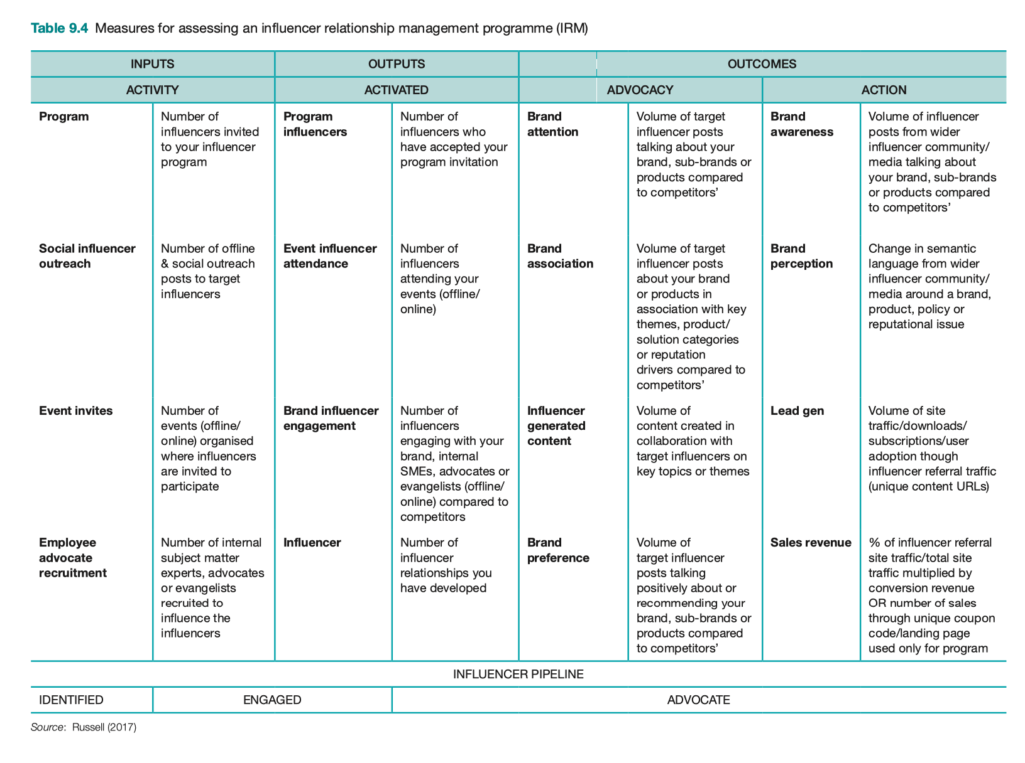

Slide 23
Digital partnerships including affiliate marketing
Working with partner sites in influencer outreach is a key part of content marketing, SEO, and online PR → Resources must be devoted to managing your online partners.
Three key types of online partnerships that need to be managed:
co-marketing and influencer outreach (covered in the previous section);
affiliate marketing
online sponsorship
Co-marketing: A partnership agreement reached between different businesses to promote each other, typically based on sharing content (and potentially promotions) principally to the audience of owned media channels such as social media, blog, and email marketing.
Notes:
- Khái niệm: Đây là một hình thức quảng cáo thuộc kênh Digital Marketing – một trong các kênh marketing phổ biến hiện nay. Theo đó marketer sẽ sử dụng quảng cáo biểu ngữ cùng với các định dạng quảng cáo trực quan khác để quảng cáo sản phẩm của họ trên các trang web, ứng dụng hoặc phương tiện truyền thông xã hội
Nhóm phương tiện:
+ Quảng cáo lập trình sẵn
+ Quảng cáo tự nhiên có trả phí
+ Quảng cáo qua hoạt động tài trợ
Traditionally, the most common payment is according to the number of customers who view the page as a cost-per-thousand (CPM) ad or page impressions. Typical CPM is in the range £10–30. Other options that benefit the advertiser if they can be agreed are per click-through or per action, such as a purchase on the destination site. Although initially media owners were able to control charging rates and largely used a per-exposure model, with the increase in unused ad inventory there has also been an increase in results-based payment methods, particularly within ad networks.
The options for purchasing and managing display advertising are now much more complex, as suggested by the summary in Figure 9.10 of the ad buying ecosystem created by the IAB. A major change in online advertising is through the use of new programmatic ad buy- ing techniques, based on demand-side platforms (DSPs), which use an approach called real-time bidding (RTB). Progammatic ads now account for the majority of online display advertising by large companies (excluding spend on search and social network ads), see for example Joseph (2020). Traditionally, display ads have been served to target audiences based

Slide 24
Affiliate marketing
Definition:
A commission-based arrangement where referring sites (publishers) receive a commission on sales or leads by merchants (retailers or other transactional sites). Commission is usually based on a percentage of product sale price or a fixed amount for each sale (CPA, or cost-per-acquisition), but may also sometimes be based on a per-click basis, for example when an aggregator refers visits to merchants.
Options of affiliate marketing models:
Aggregators. These are the major comparison sites.
Review sites.
Rewards sites/ Voucher code sites.
Bloggers.
Everyone else.
Performance marketing
Sometimes used as an alternative term for affiliate marketing
includes payment for lead, sale, and click, so it is a broader term including other online paid media such as display advertising and biddable media including pay-per-click and programmatic advertising.
Notes:
Performance marketing
Sometimes used as an alternative term for affiliate marketing, which includes payment for lead, sale, but also click, so it is a broader term including other online paid media such as display advertising and biddable media including pay-per- click and programmatic advertising.

Slide 25
Affiliate marketing
Advantages
SERPs visibility. Gain more visibility in the paid and natural listings of the SERPs (increase ‘share of search’ page).
Reach different audiences. Can use different affiliates to target different audiences, product categories and related phrases.
Responsiveness to marketplace changes. May be more responsive than your in-house or agency teams in terms of algorithm changes for SEO or changes in bidding approaches for PPC. They are also great at identifying gaps in your search strategy.
Target generic phrases in SERPs. Enables you to reach customers through generic phrases (e.g. ‘clothing’) at a relatively low cost if the affiliates secure better positions in natural listings.
Increase reach in SERPs. Increase the reach of your brand or campaign since affiliate ads and links featuring you will be displayed on third-party sites.
Generate awareness. Can be used to generate awareness of brand or new products for which a company is not well known.
Diversity risk. Use of affiliates reduces the risk caused by temporary or more fundamental problems with your SEM management or other digital marketing programs
Pay-per-performance.
Disadvantages
Incremental profit or sales may be limited. You may be cannibalising business you would have achieved anyway.
Affiliates may exploit your brand name.
May damage brand reputation. Your ads may be displayed on sites inconsistent with your brand image, such as gambling or pornography sites. Alternatively, creative may be out of date, which could be illegal.
Programme management fees. If using an affiliate network to manage your campaigns they may take up to 30 percent of each agreed affiliate commission as additional ‘network override’.
Programme management time. Affiliate marketing is founded on forming and maintaining good relationships. This cannot be done through the agency alone and marketers within a company need to speak to their top affiliates.
Notes:
Affiliates may exploit your brand name. This is particularly the case where affiliates exploit brand names by bidding on variations of it (for example ‘Dell’, ‘Dell Computers’ or ‘Dell laptop’) or by gaining a presence in the natural listings. Here there is already awareness. It is important to prevent this, and many affiliate programmes exclude brand bidding, although affiliates can have a role in displacing competitors from the listings for brand terms.

Slide 26
Affiliate marketing
Best practice in planning and managing affiliate marketing
Affiliate networks: To manage the process of finding affiliates, updating product information, tracking clicks and making payments
Commission
Cookie expiry period
Creative and links
Notes:
1 Targeting
• Search ad network strategy. Which of the search networks mentioned above do you use? • Which are used in different countries?
Display network strategy. How do you treat the Google Display Network? Do you disable
it? Create separate campaigns? Target specific sites using the Placement tool? Develop • different creative? Use placement targeting to target specific sites in Google?
Campaign structure strategy. Campaign structure is important to ensure that searches using a specific search term trigger the relevant ad creative. Are ad groups small enough to deliver a message relevant for the keyphrase entered? To understand the type of targeting that is possible, look at these two examples. First, in Figure 9.7(a) we have a campaign structure for an online clothes retailer. It monitors spend and budget by product type, so structures its campaigns accordingly and targets them nationally. Keywords related to each product will trigger ads defined within each ad group. In Figure 9.7(b) is an example
of a campaign for a restaurant chain. It monitors spend and budget by outlet, so struc-
tures its campaigns accordingly and targets them to local areas.
Keyword matching strategy. How is creative targeted using the combination of broad match, modified broad match and negative match, phrase match and exact match? Google Ads reports on click volumes for search terms or queries entered by users; these should be reviewed regularly to exclude irrelevant terms that have a low probability of
conversion by using negative matches. Search-term targeting strategy. What are the strategies for targeting different types of keyphrases such as brand, generic, product-specific and different qualifiers (cheap, com- pare, etc.)?
2 Budget and bid management
Budgeting strategy. Is budget set as maximum cost-per-click (CPC) at the appropriate level to deliver satisfactory return on investment? Is daily budget sufficient that ads are served at full delivery (always present)? Should we use Google’s machine learning bid
management tools, which can, for example, optimise on conversions? Listing position strategy. Which positions are targeted for different keywords? The effec- tiveness of this can be reviewed using a measure in Google Ads reports called Impression
Share, which enables relative reach compared to competitors to be evaluated. Bidding strategies. What is the appropriate maximum cost-per-click for different target
keywords and campaigns to maximise effectiveness? Dayparting strategy. Are ads delivered continuously through the day and week or are
certain days and times targeted (e.g. office hours, evening after ad breaks)? Bid adjustments. This is a tool to simplify the complexity of advertising when different types of mobile devices can be targeted in different locations at different times. If a business isn’t seeing such a high return on mobile devices then it can reduce
bids. Bid management tool strategy. Is a tool used to automate bidding? Which? Importance of fake clicks. Whenever the principle of PPC marketing is described to mar- keters, very soon a light bulb switches on and they ask, ‘So we can click on competitors and bankrupt them?’. Well, actually, no. The PPC ad networks detect multiple clicks from the same computer (IP address) and filter them out.
3 Creative testing and campaign optimisation
Ad creative and copy strategy. How are the 95 characters forming ad headlines, descrip- tion and creative used to encourage click-through (and reduce click-through from unqual-
ified visitors if necessary)? Is alternative copy tested? How are ads tested?
Destination or landing page strategy. How are landing pages improved?
Campaign review and optimisation strategy. What is the workflow for reviewing and
improving success? Which reports are used? How often are they reviewed? By whom?
Which tests are used? What are the follow-ups?
Specialist and innovative paid search techniques. These include ad extensions, local, inter- national and pay-per-call.
4 Communications integration
SEO integration strategy. How is SEO integrated with paid search to maximise ROI by reducing PPC spend where relevant if target keyphrases rank highly within organic
search? Affiliate integration strategy. How is affiliate marketing integrated with paid search to
maximise ROI? Marketing campaign integration strategy. How are budget and creative changed during offline campaigns?

Slide 27
Online sponsorship
Definition (Ryan and Whiteman, 2000)
… the linking of a brand with related content or context for the purpose of creating brand awareness and strengthening brand appeal in a form that is clearly distinguishable from a banner, button, or other standardised ad unit.
Sponsorship does not have to drive visitors directly to a brand site – it may be more effective if interaction occurs on the media owner’s microsite.
Co-branding is a lower-cost method of sponsorship and can exploit synergies between different companies:
An arrangement between two or more companies that agree to jointly display content and perform joint promotion using brand logos, email marketing, or banner advertisements. The aim is that the brands are strengthened if they are seen as complementary.
Co-branding is often a reciprocal arrangement, which can occur without payment as part of a wider agreement between partners.
Notes:
Online sponsorship is not straightforward. It’s not just a case of mirroring existing ‘real- world’ sponsorship arrangements in the ‘virtual world’, although this is a valid option. There are many additional opportunities for sponsorship online that can be sought out, even if you don’t have a big budget at your disposal.

Slide 28
Digital messaging including email marketing and mobile messaging
Email marketing and mobile messaging are grouped since these are both “push media”.
Three key types of online partnerships that need to be managed:
Outbound email marketing: Emails are sent to customers and prospects from an organization.
Inbound email marketing: Management of emails from customers by an organization.
Notes:
- Khái niệm email MKT: là hình thức các doanh nghiệp sử dụng email để marketing, giới thiệu sản phẩm/dịch vụ tới khách hàng mục tiêu, hỗ trợ duy trì mối quan hệ, xây dựng lòng trung thành giữa khách hàng và doanh nghiệp. Qua đó, thúc đẩy hành vi mua hàng và nâng cao hiệu quả doanh thu
- Các hình thức Email MKT :
+ Cold email: Gửi mail không được sự cho phép của KH
+ Co-branded email: Email đồng thương hiệu
+ Bản tin điện tử của bên thứ ba
+ Email đã được cho phép của khách hàng

Slide 29
Digital messaging including email marketing and mobile messaging
Opt-in email options for customer acquisition:
Cold email campaign. In this case, the recipient receives an opt-in email from an organisation that has rented an email list from a consumer email list or trade publisher and event provider. List rental is not practical today under privacy laws since permission hasn’t been sought.
Co-branded email. The recipient receives an email with an offer from a company they have an affinity with and from whom they have agreed to receive ads, eg. a publisher or retailer.
Third-party e-newsletter. A company publicizes itself in a third-party e-newsletter. This could be in the form of an ad, sponsorship or PR (editorial) in a publisher newsletter, which links through to a destination site
Notes:
- Khái niệm email MKT: là hình thức các doanh nghiệp sử dụng email để marketing, giới thiệu sản phẩm/dịch vụ tới khách hàng mục tiêu, hỗ trợ duy trì mối quan hệ, xây dựng lòng trung thành giữa khách hàng và doanh nghiệp. Qua đó, thúc đẩy hành vi mua hàng và nâng cao hiệu quả doanh thu
- Các hình thức Email MKT :
+ Cold email: Gửi mail không được sự cho phép của KH
+ Co-branded email: Email đồng thương hiệu
+ Bản tin điện tử của bên thứ ba
+ Email đã được cho phép của khách hàng

Slide 30
Digital messaging including email marketing and mobile messaging
Opt-in email options for prospect conversion and customer retention (house list)
Conversion email.
Regular e-newsletter.
different frequencies such as weekly, monthly or quarterly, with different content for different audiences and segments.
used to update consumers on the latest products or promotions, or business customers on developments within a market.
House-list campaign. Periodic emails to a list of contacts to support different objectives: encouraging trial of a service or newly launched product, repeat purchases, or reactivation of customers who no longer use a service.
Event-triggered or behavioral emails and sequences. Eg. welcome or onboarding sequences, nurture sequences, or reactivation sequences when a subscriber has become less active.
Notes:
Conversion email. Someone visits a website and expresses interest in a product or service by registering and providing their email address, although they do not buy. Automated follow-up emails can be sent out to persuade the recipient to trial the service or buy a product. For example, betting company William HillTM found that automated follow-up emails converted twice as many registrants to place their first bet compared to registrants who did not receive an email. Similarly, retailers will follow-up with ‘abandoned basket’ emails to encourage purchase where consumers have added a product to a basket and not
yet purchased. Regular e-newsletter. Options are reviewed for different frequencies such as weekly, monthly or quarterly, with different content for different audiences and segments. These are commonly used to update consumers on the latest products or promotions, or busi-
ness customers on developments within a market. House-list campaign. These are periodic emails to a list of contacts to support different objectives such as encouraging trial of a service or newly launched product, repeat pur-
chases or reactivation of customers who no longer use a service. Event-triggered or behavioural emails and sequences. The marketing automation ser- vices explained in Chapter 6 send out a series of emails, with the interval between emails and messages determined by the marketer. Examples include welcome or onboarding sequences, nurture sequences or reactivation sequences when a subscriber has become less active.

Slide 31
Email marketing
Advantages
Relatively low cost of fulfilment. The physical costs of email are substantially less than direct mail.
Direct-response medium encourages immediate action. It is one of the best methods of attracting existing customers to return to a site (it’s a push media).
Faster campaign deployment. Lead times for producing creative and the whole campaign lifecycle tend to be shorter than traditional media.
Ease of personalisation. It is easier and cheaper to personalise email than for physical media, and also than for a website.
Options for testing. It is relatively easy and cost-effective to test different email creative and messaging.
Integration. Through combining email marketing with other direct media that can be personalised, such as direct mail, mobile messaging or web personalisation, campaign response can be increased as the message is reinforced by different media.
Disadvantages
Deliverability. Difficulty of getting messages delivered through different internet service providers (ISPs), corporate firewalls and webmail systems.
Renderability. Difficulty of displaying the creative as intended within the inbox of different email reading systems.
Email response decay. Email recipients are most responsive when they first subscribe to an email but it is difficult to keep them engaged.
Communications preferences. Recipients will have different preferences for email offers, content and frequency that affect engagement and response.
Resource intensive. Although email offers great opportunities for targeting, personalisation and more frequent communications, additional people and technology resources are required to deliver these.

Slide 32
Email marketing
Best practice in planning and managing email marketing
Email service providers
Measuring email marketing: Delivery rate, open rate, click-through rate, list engagement
Email marketing success factors:
Creative.
Relevance. Does the offer and creative of the email meet the needs of the recipients?
Incentive (or offer). The WIFM (‘What’s in it for me?’) factor for the recipient.
Targeting and timing. Questions to ask include: are the creative and copy consistent with my brand? Does the message reinforce other communications? Does the timing of the email campaign fit with offline communications?
Conversation.
Attributes (of the email). Assess the message characteristics such as the subject line, from address, to address, date/time of receipt and format (HTML or text).
Landing page (or microsite).
List management
Notes:
Email marketers need to work hard to improve the quality of their list (as explained in Chapter 6). Respondents believe that the data and its selection accounted for over half of a campaign’s success. The creative and offer are still considered significant, while timing is viewed as having the least impact, accounting for just 10 per cent of the success of an email campaign. The report noted that the majority of respondents gather new email addresses through organic website traffic, with offline (paper-based) activity accounting for 40 per cent and telemarketing for 31 per cent.

Slide 33
Digital messaging including email marketing and mobile messaging
Mobile text messaging and mobile push notifications:
the amount of marketing investment and levels of activity in email marketing is far higher than in mobile text messaging;
permission-based emails are more acceptable than receiving what may be perceived as an intrusive text message on a mobile device;
mobile push notifications can be more engaging than emails.

Slide 34
Social media and viral marketing
Social media marketing: Monitoring and facilitating customer interaction and participation throughout the web to encourage positive engagement with a company and its brands. Interactions may occur on a company site, social networks, and other third-party sites _ Chafey et al., 2022
“Social media are the online means of communication, conveyance, collaboration, and cultivation among interconnected and interdependent networks of people, communities, and organizations enhanced by technological capabilities and mobility.”
“SMM is the utilization of social media technologies, channels, and software to create, communicate, deliver, and exchange offerings that have value for an organization’s stakeholders” _ Tuten et al., 2019
Notes:
Phương tiện truyền thông xã hội là phương tiện giao tiếp, truyền tải, cộng tác và phát triển trực tuyến giữa các mạng lưới liên kết và phụ thuộc lẫn nhau của con người, cộng đồng và tổ chức được tăng cường nhờ khả năng công nghệ và tính di động.

Slide 35
SMM – Social Media Marketing
Organic social media marketing
It’s common practice to distinguish between organic and paid social media marketing activities in a similar way to organic and paid search marketing.
Organic social involves using social networks and customer communities to develop relationships, share positive opinions through social media amplification , and manage negative social media comments.
Notes:
“Social media marketing is the utilization of social media technologies, channels, and software to create, communicate, deliver, and exchange offerings that have value for an organiza- tion’s stakeholders” _ Tuten et al., 2019

Slide 36
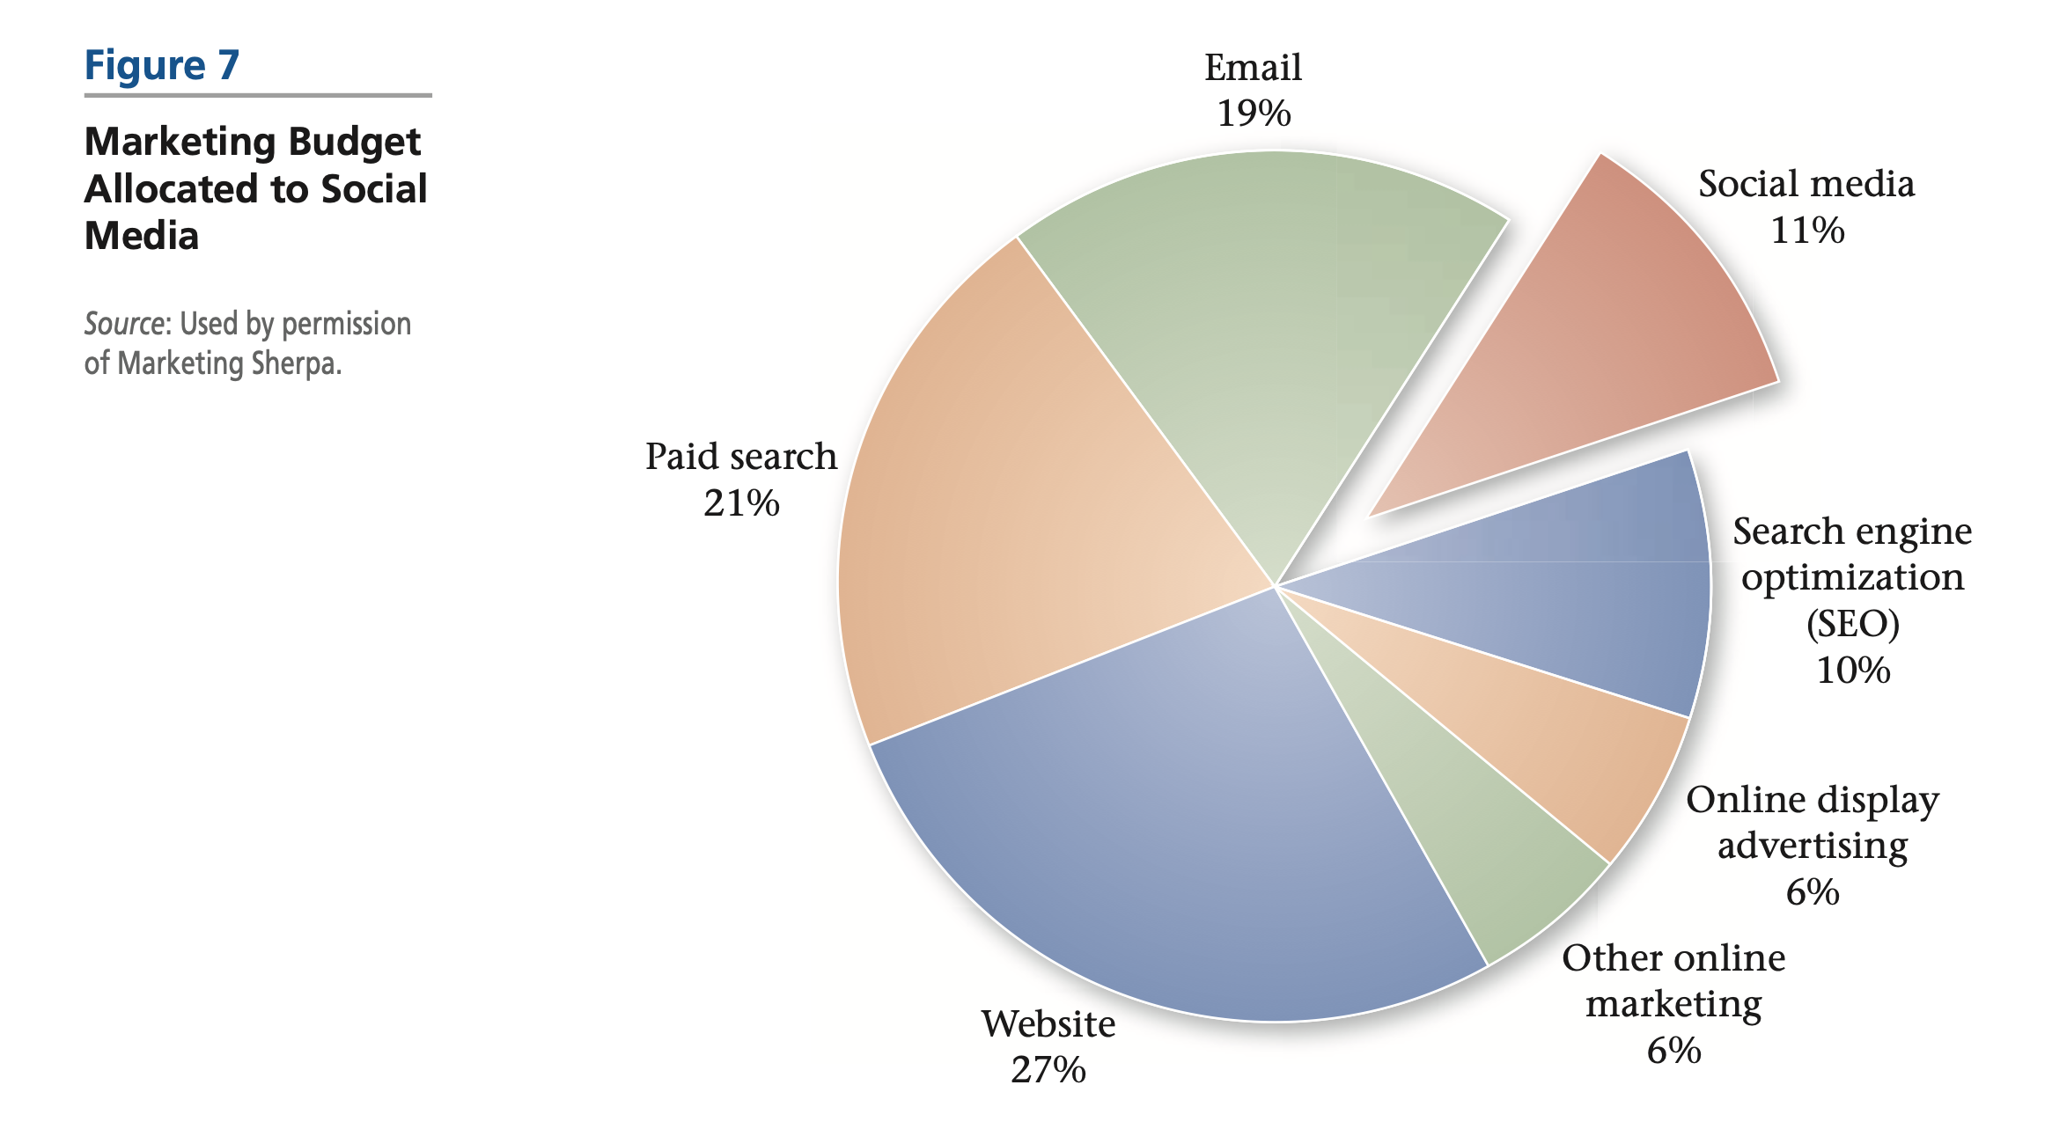
Notes:
An Illustrative Budget for a Corporate Blog
Start-up costs
Planning and development
$25,000
Training for blogger
$10,000
Ongoing costs (annual)
Blogging platform
$25,000
Brand-monitoring service
$50,000
IT support
$3,000
Content production
$150,000
Review and redirection
$20,000
Total costs for first year
$283,000

Slide 37

Viral marketing
Definition: Online viral marketing, or buzz marketing, is a form of electronic word-of- mouth marketing. Brands and promotions are discussed and awareness of them transmitted in two main forms, either as pass-along email or discussion in a social network.
...is a specific approach that involves harnessing the network effect of the Internet and can be effective in reaching a large number of people rapidly as a marketing message is quickly transmitted to many people in the same way as a natural virus or a computer virus.
... is effectively an online form of word-of-mouth communications which is sometimes also known as ‘buzz marketing’.
Word-of-mouth (WOM) marketing (the Word- of-Mouth Marketing Association -WOMMA): it is giving people a reason to talk about your products and services, and making it easier for that conversation to take place. It is the art and science of building active, mutually beneficial consumer- to-consumer and consumer-to-marketer communications.
Notes:
...is a specific approach that involves harnessing the network effect of the Internet and can be effective in reaching a large number of people rapidly as a marketing message is quickly transmitted to many people in the same way as a natural virus or a computer virus.
... is effectively an online form of word-of-mouth communications which is sometimes also known as ‘buzz marketing’.

Slide 38
Most relevant terms
Buzz marketing. Using high-profile entertainment or news to get people to talk about your brand.
Viral marketing. Creating entertaining or informative messages that are designed to be passed along in an exponential fashion, often electronically or by email.
Community marketing. Forming or supporting niche communities that are likely to share interests about the brand (such as user groups, fan clubs and discussion forums); providing tools, content and information to support those communities.
Influencer marketing. Identifying key communities and opinion leaders who are likely to talk about products and have the ability to influence the opinions of others.
Conversation creation. Interesting or fun advertising, emails, catchphrases, entertainment or promotions designed to start word-of-mouth activity.
Brand blogging. Creating blogs and participating in the blogosphere, in the spirit of open, transparent communications; sharing information of value that the blog community may talk about.
Referral programs. Creating tools that enable satisfied customers to refer their friends.
Notes:
High-profile
known and recognized by many people
famousShe went from poor and anonymous to rich and famous.
well knownShe's a well-known artist.
renownedThe area is renowned for its beauty.
world-famousThey stayed in a world-famous hotel.
celebratedHe's a celebrated writer of children's stories.
legendaryHe once met the legendary singer, Eartha Kitt.
Tiếp thị buzz. Sử dụng giải trí hoặc tin tức cao cấp để khiến mọi người nói về thương hiệu của bạn.
Tiếp thị lan truyền. Tạo các thông điệp mang tính giải trí hoặc thông tin được thiết kế để truyền đi theo cấp số nhân, thường là bằng điện tử hoặc qua email.
Tiếp thị cộng đồng. Hình thành hoặc hỗ trợ các cộng đồng thích hợp có khả năng chia sẻ sở thích về thương hiệu (chẳng hạn như nhóm người dùng, câu lạc bộ người hâm mộ và diễn đàn thảo luận); cung cấp các công cụ, nội dung và thông tin để hỗ trợ các cộng đồng đó.
Tiếp thị người ảnh hưởng. Xác định các cộng đồng quan trọng và những người dẫn dắt ý kiến, những người có khả năng nói về sản phẩm và có khả năng ảnh hưởng đến ý kiến của những người khác.
Tạo hội thoại. Quảng cáo, email, câu khẩu hiệu, giải trí hoặc khuyến mại thú vị hoặc vui nhộn được thiết kế để bắt đầu hoạt động truyền miệng.
Viết blog thương hiệu. Tạo blog và tham gia vào thế giới blog, trên tinh thần giao tiếp cởi mở, minh bạch; chia sẻ thông tin có giá trị mà cộng đồng blog có thể thảo luận.
Các chương trình giới thiệu. Tạo các công cụ cho phép khách hàng hài lòng giới thiệu bạn bè của họ.

Slide 39
Social media and viral marketing
Advantages
an effective viral agent can reach a large audience in a cost-effective way
can see how consumers rate the opinions of their peers, friends, and family
potential value can be generated through customer referrals.
Within social networks, major influencers can help spread the message more widely.
Disadvantages
high-risk marketing communications technique, since it requires a significant initial investment in the viral agent and seeding.
there is no guarantee that the campaign will ‘go viral’
challenging to engage audiences when they are socialising with their contacts and may not wish to interact with brands
Difficulty in finding the right types of content which will engage audiences and they will share with their contacts.
Seeding to key influencers can help with distributing content, but seeding is a time-consuming specialist activity.
Positive viral marketing can spread rapidly, so can negative sentiments about a company, which we referred to in the section on online reputation management
Notes:
an effective viral agent can reach a large audience in a cost-effective way
can see how consumers rate the opinions of their peers, friends, and family
potential value can be generated through customer referrals.
Within social networks, major influencers can help spread the message more widely.
high-risk marketing communications technique, since it requires a significant initial investment in the viral agent and seeding.
there is no guarantee that the campaign will ‘go viral’
challenging to engage audiences when they are socialising with their contacts and may not wish to interact with brands
Difficulty in finding the right types of content which will engage audiences and they will share with their contacts.
Seeding to key influencers can help with distributing content, but seeding is a time-consuming specialist activity.
Positive viral marketing can spread rapidly, so can negative sentiments about a company, which we referred to in the section on online reputation management

Slide 40
Social media and viral marketing
Eight ways to encourage WOM:
Implement and optimise referral programmes. Reward customers for referring new cusomers, and reward the referee as well as the referrer.
Set up brand ambassador schemes. Recruit brand fans as ambassadors, who receive exclusive merchandise/offers to share with their contacts.
Use tryvertising. A combination of ‘try’ or ‘trial’ and ‘advertising’, this is a twist on product sampling. The idea is that rather than provide free samples or trials to anyone in a target market, tryvertising involves sampling on a selective and exclusive basis to lead users – ideally with new products or services before they become widely available.
Use causal marketing. Associate your brand with a good cause that builds on brand value (e.g. Nike and anti-racism in sport).
Measure your Net Promoter Score (NPS). Track your NPS at all brand touchpoints to find out what you are doing right, and what needs to be improved.
Start an influencer outreach programme. Reach out to the 10 per cent who tell the other 90 per cent what to try and buy with special offers and programmes.
Harness the power of empowered involvement. Create advocacy – let your lead clients, customers or consumers call the shots on your innovation and marketing with VIP votes and polls. Focus innovation on doing something worth talking about. Do something new that delivers an experience that exceeds expectations.
Notes:
Understand consumers’ motivations for using social networks. Ads will be most effective if they are consistent with the typical lifestage of networkers or the topics that are being discussed.
Express yourself as a brand. Use the web to show the unique essence of your brand, but think about how to express a side of the brand that it is not normally seen.
Create and maintain good conversations. Advertisers that engage in discussions are more likely to resonate with the audience, but once conversations are started they must be followed through.
buying ad space, creating a brand space or brand channels
Empower participants: For example, in the first six months of launching charity donation widgets, 20,000 have been used online and they became one of the biggest referrers to the JustGiving website and driving more people to fundraising pages to make donations (JustGiving, 2007).
Oreo promised to analyze fans’ most recent tweets and provide a customized “Oreoscope” containing details about their personality. Moreover, they connected horoscope personality to the brand’s products, leveraging people’s obsession with how the stars are aligned.
This is another great example of personalization. It makes people feel special and it will never be outdated. The brand obviously published a great number of Oreoscopes. But, getting your personal one still makes you feel special and encourages you to share the results with others.
mua không gian quảng cáo, tạo không gian thương hiệu hoặc kênh thương hiệu
Trao quyền cho những người tham gia: Ví dụ: trong sáu tháng đầu tiên tung ra các tiện ích quyên góp từ thiện, 20.000 đã được sử dụng trực tuyến và chúng trở thành một trong những nguồn giới thiệu lớn nhất đến trang web JustGiving và thúc đẩy nhiều người hơn đến các trang gây quỹ để quyên góp (JustGiving, 2007).
Oreo hứa sẽ phân tích các tweet gần đây nhất của người hâm mộ và cung cấp một “Oreoscope” tùy chỉnh chứa thông tin chi tiết về tính cách của họ. Hơn nữa, họ đã kết nối tính cách tử vi với các sản phẩm của thương hiệu, tận dụng nỗi ám ảnh của mọi người về cách các ngôi sao thẳng hàng.
Đây là một ví dụ tuyệt vời khác về cá nhân hóa. Nó làm cho mọi người cảm thấy đặc biệt và nó sẽ không bao giờ lỗi thời. Thương hiệu rõ ràng đã xuất bản một số lượng lớn Oreoscopes. Tuy nhiên, nhận được kết quả cá nhân vẫn khiến bạn cảm thấy đặc biệt và khuyến khích bạn chia sẻ kết quả với người khác.
(horoscope):
Zodiac

Slide 41
Approaches to taking advantage of social networking (Microsoft, 2007)
Empower participants. Social network users use their space and blogs to express themselves. Providing content or widgets to associate themselves with a brand may be appealing.
Identify online brand advocates. Use reputation management tools to identify influential social network members who are already brand advocates. Approach the most significant ones directly.
The golden rule: behave like the best social networker through:
being creative;
being honest and courteous (ask permission);
being individual;
being conscious of the audience;
updating regularly.
Notes:
Identify online brand advocates. → Consider using contextual advertising such as Microsoft content ads or Google AdSense to display brand messages within their spaces when brands are discussed.
Gillette started a social media campaign in January 2019 that sought to redefine what it means to be a man.
The short clip, which was only available on YouTube, showed a number of instances in which men struggled with the conventional masculinity that Gillette itself had previously praised: the inability to express their feelings, sexual misconduct, and bullying of others. The movie then gives various illustrations of good masculinity, like speaking up for others, taking care of your family, etc.
this campaign was successful in addressing a topic that is both very present and hotly debated.
It contrasted Gillette’s prior branding with its new one and demonstrated its readiness to adapt.
At the same time, it was also highly divisive; some people found how males were represented in the short film insulting. This brought the brand even more, reach and mentions in the media.
Empower participants. Social network users use their space and blogs to express themselves. Providing content or widgets to associate themselves with a brand may be appealing.
Identify online brand advocates. Use reputation management tools to identify influential social network members who are already brand advocates. Approach the most significant ones directly.
The golden rule: behave like the best social networker through:
being creative;
being honest and courteous (ask permission);
being individual;
being conscious of the audience;
updating regularly.

Slide 42
Social media and viral marketing
Best practice in planning and managing viral marketing
Creative material – the ‘viral agent’. This includes the creative message or offer and how it is spread (text, image, video).
Seeding. Identifying websites, blogs, or people to send email to, to start the virus spreading. Seeding can also be completed by email to members of a house list or by renting a list.
Tracking. To monitor the effect and to assess the return from the cost of developing the viral agent and seeding.

Slide 43
Chapter reference
Chaffey D. & Ellis-Chadwick F. (2022). Digital marketing - Strategy, Implementation and Practice (8th edition), chapter 9. Pearson. UK

Slide 44


